Slide 1
Approaches to User Experience Design (Learn & Try) Session #03
Course : GAME6012/ User Experiences
Effective Period : September 2017

Slide 2
These slides have been adapted from: Julie A. Kientz (2014). User Experience Design, University of Washington.
Acknowledgement

Slide 3
Learning Objectives

Slide 4
4 Approaches that can help us start
Look at what users really do
Ask users to help
Learn from the fact you gathered
Try it yourself

Slide 5
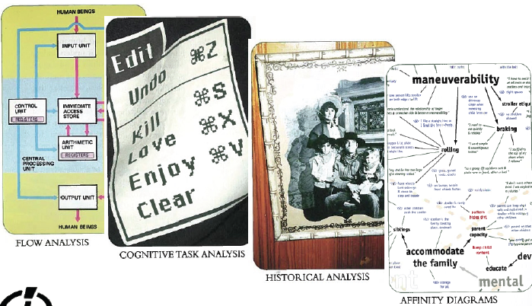
LEARN from the facts you gather

Slide 6
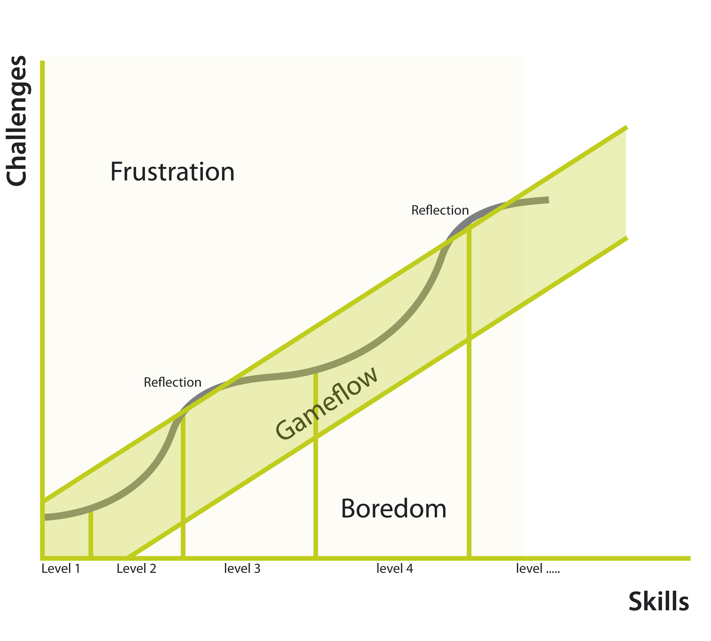
See what happen

Slide 7

TRY it yourself with others

Slide 8
Recruit Your Target Player
When designing your playtest, you should be keenly familiar with the type of player your game is for. While your game may appeal to a larger audience, it's a mistake to "design for all." We find it helpful to identify personas for our target audience -- for example, "Jane, 25-34 years old, owns an iPhone" -- and try to recruit players who closely match that description.

Slide 9
Test Your Test Before You Test!
Before your testers arrive, set aside some time for everyone on your team involved in the playtest to do a run through. Testing your playtest will ensure things run as smoothly as possible, by ironing out the kinks ahead of time and getting the whole team on the same page.

Slide 10
Take the Pressure Off
The concept of playtesting is still new to some game developers; for the average human being, it is completely foreign. Your playtesters may be unsure of what to expect, and that uncertainty can have a negative effect on your test results.Make your playtesters comfortable so they can focus on playing your game and you'll get much better feedback.

Slide 11
Rock the Survey
Always ask your players some questions after they're done playing. Try to predict these questions ahead of time and put them in survey form so that you collect the same set of data for every playtester. If you have any spontaneous follow-up questions, you can ask them when they're done taking the survey.

Slide 12
Analyse in Aggregate
After a playtest, you're going to have survey results and notes from many different playtesters and observers. Compile that data quickly and share it with your team in aggregate, without offering analysis or drawing conclusions.
Analyze the results as a group, and start on the aggregate data -- your game designer may have seen one player who thought the game was too easy, but is that what everyone else saw? If all the other players said the game was difficult then you know that "too easy" is not a trend. If you like you can still return to that playtester's feedback afterward and address it as a special case. Analyzing your data in aggregate first will guarantee that your entire team benefits from the full playtest.

Slide 13
Assignment
Continue from your previous game
Observe the player (Again)
What can you impove from the game by observing the player
Confirm your finding on the player

Slide 14
References
Buxton, William. 2007. Sketching user experience. Elsevier
Anderson, Stephen. 2011. Seductive Interaction Design. New Riders.
Faranello, Scott. 2016. Practical UX Design. Packt Publishing

